Slide 1


Slide 2

Introduction to JavaScript
Jhon Guerrero
System Engineer
Software Developer
@jarneygm

Slide 3
Introduction to JavaScript
Short history
What’s is JavaScript?
Creator
Set up development environment
Text editor
JavaScript interpreter
Debug tool
Frameworks
Basic concept
Number
String
Boolean
Object
Function
Array
Date
RegExp
Null
undefined

Slide 4
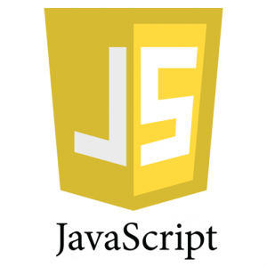
What’s JavaScript?
JavaScript (JS) is a programming language primarily used by web browsers for dynamic scripting of web pages. It can also be used on the server side to perform any sort of action.
Notes:
Unlike most programming languages, the JavaScript language has no concept of input or output. It is designed to run as a scripting language in a host environment, and it is up to the host environment to provide mechanisms for communicating with the outside world. The most common host environment is the browser, but JavaScript interpreters can also be found in Adobe Acrobat, Photoshop, SVG images, Yahoo!'s Widget engine, as well as server side environments such as node.js. However the list of the areas where JavaScript is used just begins here. It also includes NoSQL databases, like the open source Apache CouchDB, embedded computers, or complete desktop environments, like GNOME (one of the most popular GUIs for GNU/Linux operating systems).

Slide 5

Creator
JavaScript was created in 1995 by Brendan Eich, an engineer at Netscape, and first released with Netscape 2 early in 1996. And has several names like: Mocha, LiveScript, JScript, ECMAScript and JavaScript.

Slide 6
Set up development environment
Text Editor
JavaScript interpreter
Visual Studio Community Edition (http://www.visualstudio.com/en-us/products/visual-studio-community-vs.aspx)
Sublime Text (http://www.sublimetext.com/)
Notepad++ (http://www.notepad-plus-plus.org/)
Any popular browser
Node.js (http://nodejs.org/)

Slide 7
Set up development environment
Debugs Tools
Frameworks
Developers tools (Browser)
Firebug
JQuery
Prototype
AngulrJS
MooTools

Slide 8
Basic concept
JavaScript is an object oriented dynamic language; it has types and operators, standard built-in objects, and methods. Its syntax comes from the Java and C languages, so many structures from those languages apply to JavaScript as well
Notes:
One of the key differences is that JavaScript does not have classes; instead, the class functionality is accomplished by object prototypes. The other main difference is that functions are objects, giving functions the capacity to hold executable code and be passed around like any other object.
Number
String
Boolean
Object
Function
Array
Date
RegExp
null
undefined

Slide 9
Numbers
In JavaScript are "double-precision 64-bit format IEEE 754 values", according to the spec.
Notes:
Some build-in function:
Math object
parseInt and parseFloat (functions)
unary + operator for convert
NaN and isNaN (function)
Infinity, minus Infinity and isFinite

Slide 10
Strings
Strings in JavaScript are sequences of characters. More accurately, they are sequences of Unicode characters, with each character represented by a 16-bit number.
Notes:
Some build-in function:
chartAt (function)
replace (function)
toUpperCase (function)

Slide 11
Others types
JavaScript distinguishes between null, which is a value that indicates a deliberate non-value (and is only accessible through the null keyword), and undefined, which is a value of type 'undefined' that indicates an uninitialized value — that is, a value hasn't even been assigned yet.
Notes:
(undefined is a constant)
JavaScript has a boolean type, with possible values true and false (both of which are keywords). Any value can be converted to a boolean according to the following rules:
false, 0, the empty string (""), NaN, null, and undefined all become false.
all other values become true.
(Use Boolean function for checking)

Slide 12
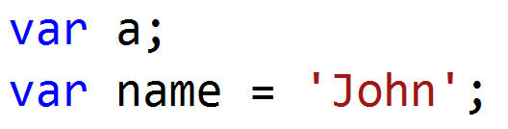
Variables
New variables in JavaScript are declared using the var keyword:
Notes:
An important difference from other languages like Java is that in JavaScript, blocks do not have scope; only functions have scope. However, starting with ECMAScript Edition 6, let and const declarations allow you to create block-scoped variables

Slide 13
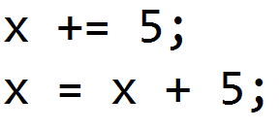
Operators
JavaScript's numeric operators are +, -, *, / and % - which is the remainder operator. Values are assigned using =, and there are also compound assignment statements such as += and -=. These extend out to x = x operator y.
Notes:
You can use ++ and -- to increment and decrement respectively. These can be used as prefix or postfix operators.

Slide 14
Operators
The + operator also does string concatenation:
Notes:
If you add a string to a number (or other value) everything is converted in to a string first. This might catch you up:
"3" + 4 + 5; // "345"
3 + 4 + "5"; // "75"
Adding an empty string to something is a useful way of converting it.

Slide 15
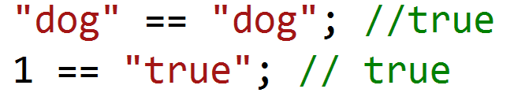
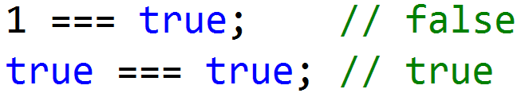
Operators
Comparisons in JavaScript can be made using <, >, <= and >=. These work for both strings and numbers. Equality is a little less straightforward. The double-equals operator performs type coercion if you give it different types, with sometimes interesting results:
To avoid type coercion, use the triple-equals operator:
Notes:
There are also != and !== operators.
JavaScript also has bitwise operations.

Slide 16
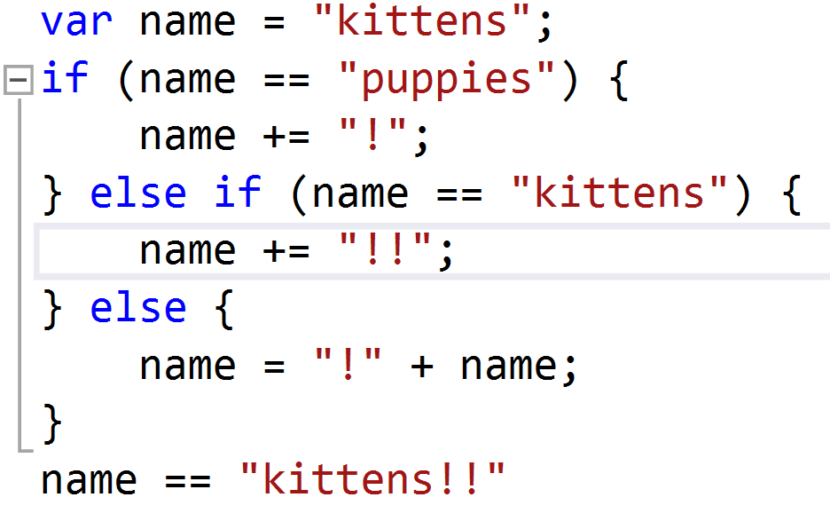
Control Structure
JavaScript has a similar set of control structures to other languages in the C family.

Slide 17
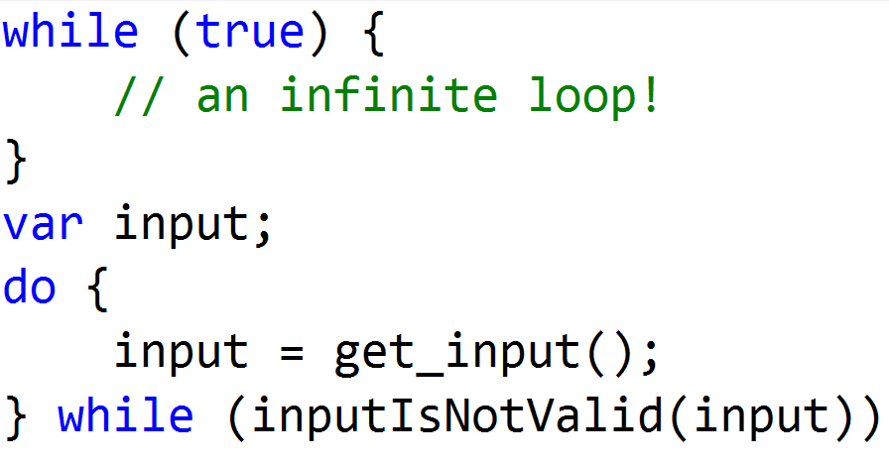
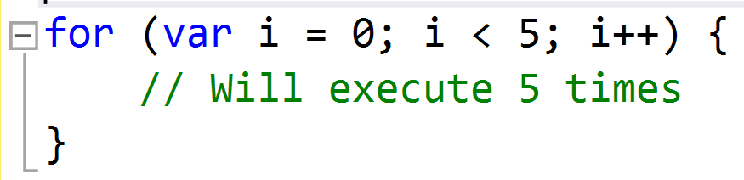
Control Structure
JavaScript has while loops and do-while loops
JavaScript's for loop is the same as that in C and Java

Slide 18
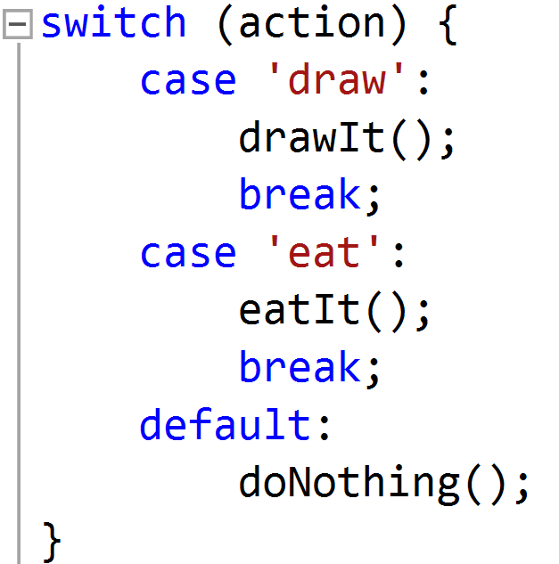
Control Structure
The switch statement can be used for multiple branches based on a number or string:
Notes:
The && and || operators use short-circuit logic, which means whether they will execute their second operand is dependent on the first. This is useful for checking for null objects before accessing their attributes:
var name = o && o.getName();
Or for setting default values:
var name = otherName || "default";
JavaScript has a ternary operator for conditional expressions:
var allowed = (age > 18) ? "yes" : "no";

Slide 19
Objects
JavaScript objects can be thought of as simple collections of name-value pairs. As such, they are similar to:
Dictionaries in Python
Hashes in Perl and Ruby
Hash tables in C and C++
HashMaps in Java
Associative arrays in PHP
There are two basic ways to create an empty object:

Slide 20
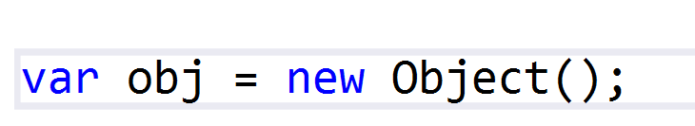
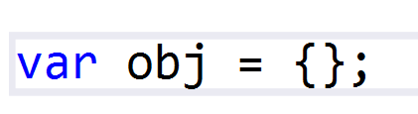
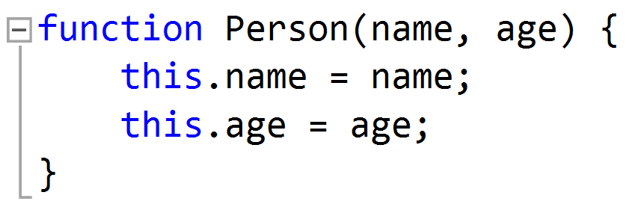
Objects

Slide 21
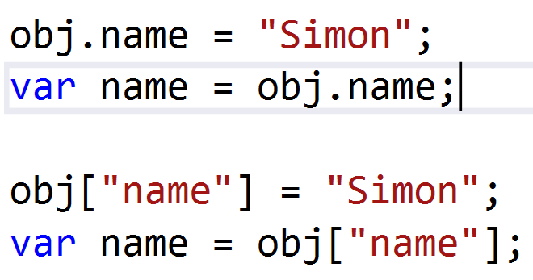
Objects
Once created, an object's properties can again be accessed in one of two ways:
Notes:
These are also semantically equivalent. The second method has the advantage that the name of the property is provided as a string, which means it can be calculated at run-time though using this method prevents some JavaScript engine and minifier optimizations being applied. It can also be used to set and get properties with names that are reserved words:

Slide 22
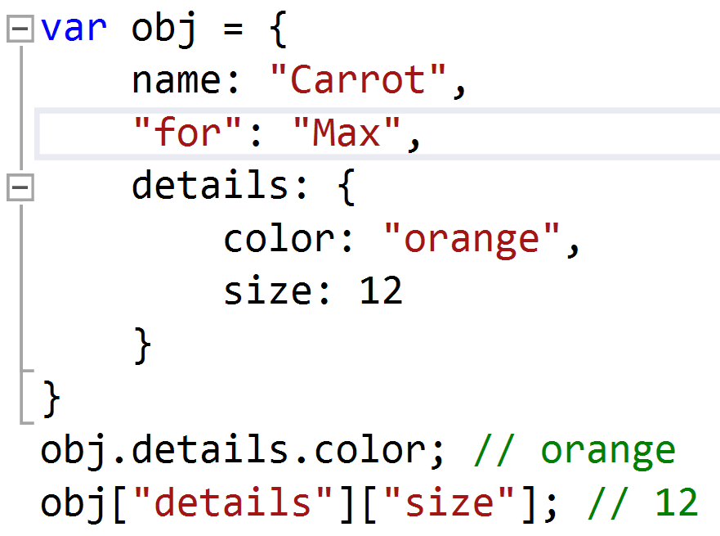
Objects
Object literal syntax can be used to initialize an object in its entirety:

Slide 23
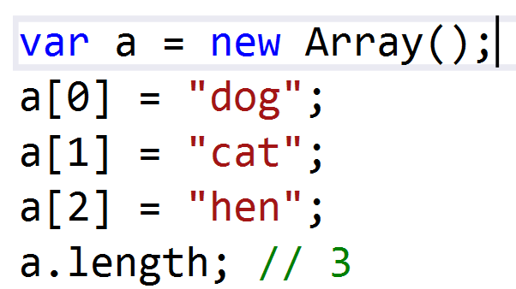
Arrays
Arrays in JavaScript are actually a special type of object. They work very much like regular objects (numerical properties can naturally be accessed only using [] syntax) but they have one magic property called 'length'.

Slide 24
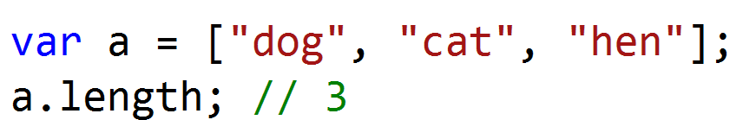
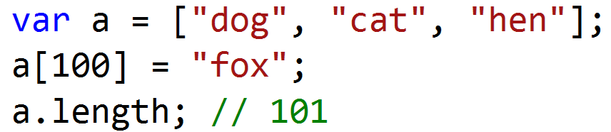
Arrays
A more convenient notation is to use an array literal:
Note that array.length isn't necessarily the number of items in the array. Consider the following:
Notes:
If you take the above into account, you can iterate over an array using the following:
for (var i = 0; i < a.length; i++) {
// Do something with a[i]
}
This is slightly inefficient as you are looking up the length property once every loop. An improvement is this:
for (var i = 0, len = a.length; i < len; i++) { // Do something with a[i]
}
An even nicer idiom is:
for (var i = 0, item; item = a[i++];) {
// Do something with item
}
Another way to iterate is to use the for...in loop. Note that if someone added new properties to Array.prototype, they will also be iterated over by this loop:
for (var i in a) {
// Do something with a[i]
}

Slide 25
DEMO

